Slide 1
User Acceptance of Information Technology: Theories and Models
(Andrew DILLON, Michael G. MORRIS - 1996)
presented by
Bengül BAYRAKTAROĞLU
Notes:
Today, I will talk about “User Acceptance of Information Technology: Theories and Models” by Andrew Dillon and Michael Morris.

Slide 2
Outline
The Concept of Acceptance
Innovation Diffusion Theory
Theoretical Approaches to Understanding the Psychology of User Acceptance
  The Theory of Reasoned Action (TRA)
  The Technology Acceptance Model (TAM)
  Differences between TRA and TAM
  Theory of Planned Behavior (TPB)
  Related Work
Theoretical Approaches to the Design of Acceptable Technology
  Socio-Technical Systems Theory of Acceptance
  Related Theories of Acceptance
  Human-Computer Interaction and the Usability Engineering Approach to Acceptance
  Related Work
Conclusion
Notes:
Here is the outline for my presentation.

Slide 3
The Concept of Acceptance
User acceptance is the demonstrable willingness within a user group to employ IT for the tasks that technology is designed to support.
  Employing without providing evidence of use
  Employing for purposes unintended by the designers
Lack of user acceptance is a significant barrier to the success of new information systems.
  The more unwilling to use » the more success
The search for a single-variable answer is unlikely to yield an explanation of the level of acceptance.
Notes:
User acceptance is the demonstrable willingness within a user group to employ IT for the tasks that technology is designed to support.
According to this definition the concept cannot be applied to situations in which users will employ it without providing evidence of use, or for purposes unintended by the designers.
However, the process of acceptance can be modeled and predicted according to the essence of acceptance theory.
Lack of user acceptance is a significant barrier to the success of new information systems.
Because users are often unwilling to use IS which, if used, would result in impressive performance gains.
Therefore, user acceptance has been viewed as the major factor in determining the success or failure of any IS project.
The search for a single-variable answer is unlikely to yield an explanation of the level of acceptance.
Yet there are distinct trends in the field that suggest the issue is not intractable. I will continue with these trends.

Slide 4
Innovation Diffusion Theory
Primary intention is to provide an account of the manner in which any technological innovation moves from the stage of invention to widespread use.
Five characteristics of innovations
  Relative advantage » A technology offers improvements over available tools or not
  Compatibility » Its consistency with social practices and norms among its users
  Complexity » Its ease of use or learning
  Trialability » The opportunity to try before using it
  Observability » Technology's outputs can be observed or not
Notes:
Innovation diffusion theory is the principal theoretical perspective on acceptance.
Its primary intention is to provide an account of the manner in which any technological innovation moves from the stage of invention to widespread use.
Diffusion theory implies five characteristics of innovations that affect their diffusion: relative advantage, compatibility, complexity, trialability, and observability.

Slide 5
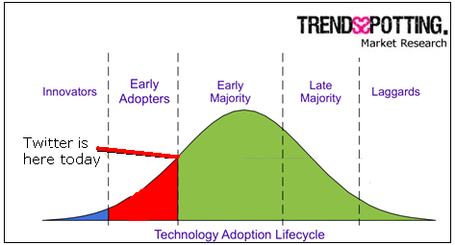
Innovation Diffusion Theory (cont’d)
Innovation adopters
  Innovators
  Early adopters
  Early majority
  Late majority
  Laggards
Notes:
Innovation diffusion theory suggests that factors at the level of the individual user are also important
Innovation adopters can be divided into five categories depending on their speed of adoption: innovators, early adopters, early majority, late majority, and laggards.
Recent research has attempted to extend diffusion theory to more complex adoption scenarios. For example, according to researches managerial influence in the organization can encourage acceptance through reward systems and incentives.

Slide 6
Theoretical Approaches to Understanding the Psychology of UA
Acceptance as an outcome in a psychological process
Little or no emphasis on the design of interfaces
The dynamics of human decision making in the context of accepting or resisting technology
The Theory of Reasoned Action (TRA)
The Technology Acceptance Model (TAM)
Differences between TRA and TAM
Theory of Planned Behavior (TPB)
Related Work
Notes:
Acceptance has been seen as an outcome in a psychological process. Users go through in making decisions about technology. In this work, there is little or no emphasis on the design of interfaces.
Instead, this research seeks to understand the dynamics of human decision making in the context of accepting or resisting technology. Much of this work comes from the field of Management Information Systems.
Research seeks to predict how users in an organization will react to new technologies.
Now, I will go on with TRA, TAM, differences between TRA and TMA, then, TPB, and related work.

Slide 7
The Theory of Reasoned Action (TRA)
Relationships between beliefs, attitudes, norms, intentions, and behavior⁽¹⁾
  Behavior⁽¹⁾ is determined by intention⁽²⁾ to perform the behavior,
    Intention⁽²⁾ is influenced by attitude⁽³⁾ and norm,
      Attitude⁽³⁾ is determined by beliefs⁽⁴⁾ about the consequences of the behavior and the evaluation of those consequences,
        Beliefs⁽⁴⁾ are defined as the individual's probability that performing a given behavior will result in a given consequence.
Notes:
TRA in the social psychology defines relationships between beliefs, attitudes, norms, intentions, and behavior.
According to this theory, an individual's behavior is determined by his or her intention to perform the behavior.
This intention is influenced by the individual's attitude and norm.
According to TRA, attitude toward a behavior is determined by beliefs about the consequences of the behavior and the evaluation of those consequences.
Beliefs are defined as the individual's probability that performing a given behavior will result in a given consequence.

Slide 8
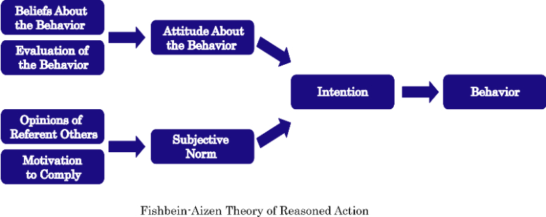
The Theory of Reasoned Action (TRA) (cont’d)
Information processing view of attitude formation and change
External stimuli influence attitudes only through changes in the person's belief structure
The end result is a generalized model for understanding the determinants of human behavior in situations where people make choices.
Notes:
This approach represents an information processing view of attitude formation and change.
It states that external stimuli influence attitudes only through changes in the person's belief structure.
However, attitude alone does not solely determine behavioral intentions. Intentions are determined also by norms.
The end result is a generalized model for understanding the determinants of human behavior in situations where people make choices.
The model is used to make predictions of human choice in situations as diverse as voting in elections.

Slide 9
The Technology Acceptance Model (TAM)
Predict acceptance and diagnose design problems before using.
Acceptance is determined by two factors: perceived usefulness (U) and perceived ease of use (EOU).
(U) » the degree to which a user believes that using the system will enhance his or her performance
(EOU) » the degree to which the user believes that using the system will be free from effort.
Notes:
The goal of TAM is to predict acceptance and diagnose design problems before using. According to TAM, acceptance is determined by two factors: perceived usefulness and perceived ease of use.
Perceived usefulness is defined as the degree to which a user believes that using the system will enhance his or her performance.
Perceived ease of use is defined as the degree to which the user believes that using the system will be free from effort. Both U and EOU are related to specific beliefs of users.

Slide 10
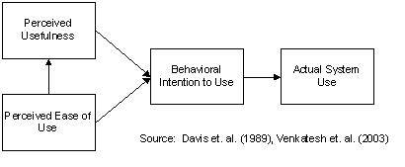
The Technology Acceptance Model (TAM) (cont’d)
User's attitude toward using the system (A) is defined as feelings of favorableness toward the system.
Behavioral intentions to use the system (BI) are modeled as a function of (A) and (U).
(BI) is the strongest predictor of actual use.
Notes:
Usefulness and ease of use have a significant impact on a user's attitude toward using the system.
Behavioral intentions to use the system are modeled as a function of A and U.
BI then determines actual use.
Researches have consistently shown that BI is the strongest predictor of actual use.

Slide 11
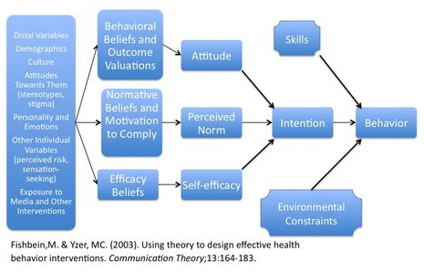
Differences between TRA and TAM
Several differences
Subjective norms are not significant predictors of intentions
Intentions to use » impact on job performance
  One may dislike a system but still use it if it increase performance
Notes:
There are several differences between TRA and TAM.
Subjective norms were not found to be important predictors of intentions by TAM researchers. Thus, use of technology was not dependent others’ use of the same technology, system usage was not likely driven by social influences.
According to Davis intentions to use IT may be based on its impact on job performance, regardless of the individual's overall attitude toward that system. For instance, even though an employee may dislike a system, that employee may still use the system if it is perceived to increase job performance.

Slide 12
Differences between TRA and TAM (cont’d)
The direct effect of perceived ease of use on perceived usefulness
  A user should find the easier one to be more useful
Davis » TAM was a better predictor of intentions to use a particular software package
Mathieson » TAM predicted intention to use a spreadsheet package.
Todd » TAM provided a good fit to data on the use of a computing resource center.
Notes:
There is also the direct effect of perceived ease of use on perceived usefulness. Facing two systems offering identical functionality, a user should find the easier one to be more useful.
Davis found that TAM was a better predictor of intentions to use a particular software package. Mathieson found that TAM predicted intention to use a spreadsheet package.
Todd found that TAM provided a good fit to data on the use of a computing resource center.

Slide 13
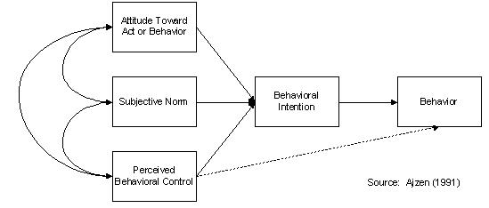
Theory of Planned Behavior (TPB)
TPB = TRA + Perceived behavioral control
Perceived behavioral control
  Availability of skills
  Availability of resources
  Availability of opportunities
Notes:
The Theory of Planned Behavior adds a third factor, perceived behavioral control, to the TRA model.
Perceived behavioral control is determined by the availability of skills, resources, and opportunities.

Slide 14
Theory of Planned Behavior (TPB) (cont’d)
Mathieson
  TPB did not provide as complete an explanation of intention as TAM.
  TAM was easier to apply.
Todd
  TAM was a better predictor of usage.
  If the goal is to predict IT usage, TAM may be better.
  If the goal is to better understand specific determinants of intention, TPB may be better.
Notes:
Mathieson tested both TAM and TPB and found that TPB did not provide as complete an explanation of intention as TAM and noted that TAM was easier to apply.
Todd tested TPB and found that TAM was a better predictor of usage. If the goal is to predict IT usage, TAM may be better.
If the goal is to better understand specific determinants of intention, TPB may be better.

Slide 15
Related Work
Igberia demonstrates the importance of experience on acceptance
Dwyer » user training influences acceptance by impacting satisfaction and user confidence
Alavi » the individual user factors
  Cognitive style » the characteristic ways in which individual process and use information
  Personality » impact acceptance include need for achievement, degree of defensiveness, and locus of control, dogmatism, and risk-taking propensity
  Demographics » variables like age and education influences use of technology, but the relationship is not strong enough to account
  User-situational variables » training, experience, and user involvement, correlate well with acceptance.
Notes:
Other theorists have proposed psychological variables that influence acceptance independently of the TAM or TRB frameworks.
For example, Igberia demonstrates the importance of experience on acceptance.
Dwyer suggests that user training influences acceptance by impacting satisfaction and user confidence.
Alavi suggests that the individual user factors like cognitive style, personality, demographics, and user-situational variables are the ones that are the most relevant to acceptance.
Both individual and tool-specific characteristics are important.
However there is a lack of theoretical models that link both perspectives in understanding the nature of acceptance.

Slide 16
Theoretical Approaches to the Design of Acceptable Technology
Acceptance at the level of technology development and its costs
Implementation and use issues at the organizational level are more than just the composite of individual utility and ease of use ratings
Socio-Technical Systems Theory of Acceptance
Related Theories of Acceptance
Human-Computer Interaction and the Usability Engineering Approach to Acceptance
Related Work
Notes:
There is a need to address acceptance at the level of technology development and its costs.
Even if individual acceptance could be assessed:
Implementation and use issues at the organizational level are more than just the composite of individual utility and ease of use ratings.
Now, I will continue with Socio-Technical Systems Theory of Acceptance, Related Theories of Acceptance, Human-Computer Interaction and the Usability Engineering Approach to Acceptance, and Related Work

Slide 17
Socio-Technical Systems Theory of Acceptance
Organizational impact of technology
A technology on its own has little meaning for purposes of organizational analysis
The gainful employment of any technology depends on the ability and willingness of users
A design process is to ensure as much a social solution as a technical solution to the computing needs of an organization
Notes:
The socio-technical systems theory is important in the analysis of the organizational impact of technology.
According to this theory a technology on its own has little meaning for organizational analysis. The gainful employment of any technology depends on the ability and willingness of users. So, technology cannot be analyzed without organization aspect.
This theory provided a framework for technology design that focus on user participation in the development.
Socio-technical systems theory has given birth to a framework for technology design that emphasizes holistic job satisfaction and user participation throughout the development process.
The analysis of all stakeholders is recommended, not just the direct users of a technology.

Slide 18
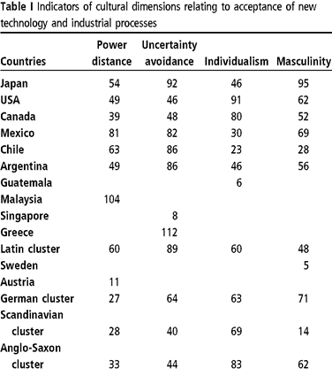
Socio-Technical Systems Theory of Acceptance (cont’d)
More management-oriented than truly user-centered
Acceptance as two forces: control and enhancement
The users' perception of control reduces » the risk of resistance increases
Evidence for effects of control and enhancement variables on acceptance is scarce
Notes:
This theory has been criticized by some researchers as more management-oriented than truly user-centered.
However, it has been pioneer in shifting technology design away from just financial and technical concerns.
Socio-technical researchers see acceptance as two forces: control and enhancement. Control factors are imposing rules and structures upon the users, thereby removing autonomy (control over their own actions) from them.
Low or high presence of certain factors (low reliability, high pacing) reduce the users' perception of control and increase the risk of resistance.
Enhancement factors include sense of mastery, growth of knowledge, discretion, ability to act informally, requirement for certain skills and enabling worker cooperaiton. A technology that is designed to support such factors is likely to increase user acceptance in an organizaiton.
Evidence for effects of control and enhancement variables on acceptance is scarce
Yet these factors propose a specific path for research.

Slide 19
Related Theories of Acceptance
Collective Resources Approach
  Seeks to engage trade unions as equal partners in the planning of work and the technology.
Soft-Systems Methodology
  Seeks to encourage the development of a technology that is most suitable for any given context.
Activity Theory
  Seeks to understand human work and technology which emphasizes the long-term well-being of users.
Human-centered Design
  Denies the possibility of a scientific approach to systems design and encourages focusing on the design team.
Notes:
While the socio-technical perspective has gained most currency in the literatüre, there are several related approaches to design that warrant mention.
Collective resources approach is distinguishable in its strong political perspective.
It seeks to engage trade unions as equal partners in the planning of work and the technology.
SSM seeks to encourage the development of a technology that is most suitable for any given context.
Activity theory is an approach to understand human work and technology which emphasizes the long-term well-being of workers or users.
Human-centered design denies the possibility of a scientific approach to systems design.
It encourages focusing on the design team.

Slide 20
HCI and the Usability Engineering Approach to Acceptance
Human-Computer Interaction » more traditional human factors
Focus on the concept of usability
The more usable a technology is made » the greater its chances of acceptability
Shackel
  Utility refers to the range of functions provided by the technology.
  Usability refers to the extent to which users can employ these functions in an effective, efficient, and satisfactory manner.
  Cost is self-explanatory.
Notes:
Addressing more traditional human factors concerns of Workstation and interface design, the field of human-computer interaction (HCI) has long sought to influence the development of more user-centered technology.
HCI addresses more traditional human factors.
It concentrates heavily on the concept of usability.
Most researchers assume that the more usable a technology is made, the greater its chances of acceptability.
According to ISO 9241, the usability of an applicaiton refers to the effectiveness, efficiency and satisfaction with which specific users, performing specific tasks in specific environments, can use an applicaiton.
According to Shackel, an acceptable system is one that satisfies the requirements of its users for utility, usability, and cost.
For any one user, or organization, trade-offs between these variables may be made
For instance some users might be willing to sacrifice cost savings for greater usability while others might consider usability of lesser importance compared to financial outlay and utility.

Slide 21
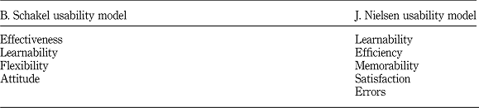
HCI and the Usability Engineering Approach to Acceptance (cont’d)
Performing task analysis
Agreeing on the utility
Testing people's use of it through effectiveness, efficiency, and satisfaction measures
Usability engineering specialists
  Seeks to influence the complete process of design
Notes:
By performing task analysis, agreeing on the utility, testing people's use of it through effectiveness, efficiency, and satisfaction measures, the HCI approach can measure and predict acceptability.
Usability engineering specialists seek to influence the complete process of design.
Although the usability makes reference to organizational level issues, it is not a major focus of this research.
Recommendations for design tend to concentrate on methods and techniques for developing the user interface.

Slide 22
Related Work
Continuum from the more technology centered to the more user-centered
Boehm
  A spiral model of software design » emphasis on prototyping and re-design
Modified Structured Systems Analysis and Design Methodology
  Acceptance might be more directly tackled
Notes:
In many ways, design methods form a continuum from the more technology centered to the more user-centered.
Boehm has proposed a spiral model of software design that places emphasis two major characteristics of usability engineering methods.
Furthermore, structured design methods such as Structured Systems Analysis and Design Methodology are modified so that acceptance might be more directly tackled.

Slide 23
Conclusion
UA is of concern to those wish to predict
  Which technologies will prove most suitable for an organization
  How a given design is received by users
Innovation diffusion theory
  Seeks to provide the characteristics of those groups who will adopt a technology at different phases
Predicting how a new technology is received is better tackled by TAM
Notes:
The question of user acceptance is of concern to those wish to predict which technologies will prove most suitable for an organization or how a given design is received by users.
Innovation diffusion theory seeks to provide the characteristics of those groups who will adopt a technology at different phases.
Predicting how a new technology is received is better tackled by TAM.

Slide 24
Conclusion (cont’d)
Socio-technical systems theory
  Enable the planning of work activities around technology in a manner that
    Minimizes resistance
    Maximizes the user satisfaction.
Usability engineering work in the field of HCI offers techniques for
  Maximizing the chances of the acceptability at the interface between the system and the individual user.
Notes:
Organizational analysis approaches, such as socio-technical systems theory,
Enable the planning of work activities around technology in a manner that
Minimizes resistance and maximizes the user satisfaction.
Usability engineering work in the field of HCI offers techniques for maximizing the chances of the acceptability at the interface between the system and the individual user.
Understanding both the practical as well as theoretical problems related to acceptance should remain important for all research in this domain.
Thank you for listening.

